Slide 1


Crop And Fertilizer Recommendation
System Using Machine Learning
Student Name: Shekhar Lalu Hotkar
AICTE Student ID:STU64e160c948be61692491977

Slide 2

Learning Objectives:
1.Understand the Need for Crop Recommendation Systems
Recognize the challenges faced by farmers in selecting suitable crops based on soil and climate conditions
2.Explore the Dataset and Features
Analyze key agricultural features like Nitrogen (N), Phosphorus (P), Potassium (K), temperature, humidity, pH, and rainfall.
Understand the target label: Crop type , Fertilizer type.
3.Learn the Data Preprocessing Workflow
Understand scaling/normalization techniques.
4.Build and Train a Machine Learning Model
We choose the Decision Tree algorithm.
Evaluate model accuracy and generalization.
GOAL
Source :
www.freepik.com/

Slide 3
Tools and Technology used:
Programming Language:
Python – For data processing, model training.
Libraries & Frameworks:
Pandas – Data manipulation and analysis
NumPy – Numerical operations and array handling
Scikit-learn – Machine learning model building and evaluation
Matplotlib – Data visualization (e.g., crop distribution, feature plots)
Pickle – Saving and loading trained models
Streamlit – Creating interactive web-based user interfaces
Development Tools:
Jupyter Notebook – For development and experimentation.
GitHub – For version control and online deployment.
Deployment:
Streamlit Cloud – Hosting the crop recommendation system.
Local Environment – Development and testing.

Slide 4
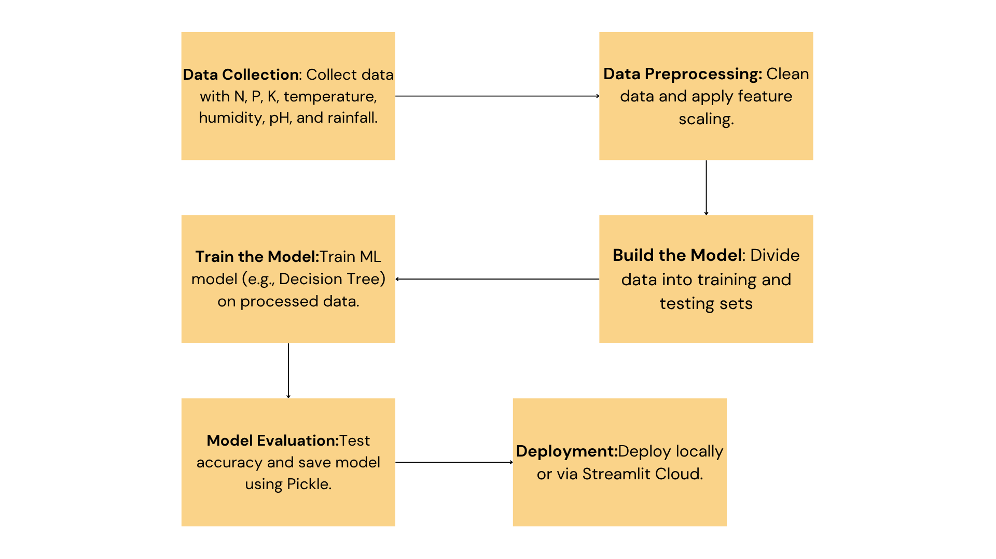
Methodology:
Flow chart:

Slide 5
Problem Statement:
Farmers often struggle to choose the right crop for cultivation and the appropriate fertilizers to apply, due to limited knowledge of soil health, weather patterns, and nutrient needs.
Incorrect crop choices and fertilizer usage can lead to:
Reduced yield and soil fertility
Increased production costs
Environmental damage due to overuse of chemicals
There is a need for a smart, data-driven system that can:
Recommend the most suitable crop based on soil nutrients (N, P, K), temperature, humidity, pH, and rainfall
Suggest the appropriate type and quantity of fertilizer to optimize growth and sustainability

Slide 6
Solution:
To solve the challenge of inefficient crop selection and fertilizer usage, we developed a Machine Learning-based dual recommendation system with a focus on Green Skills and AI for sustainable agriculture.
Crop Recommendation System:
Accepts user inputs such as:
Nitrogen (N), Phosphorus (P), Potassium (K)
Temperature, Humidity, pH, and Rainfall
Uses a trained machine learning model to predict the most suitable crop
Helps improve yield and resource efficiency
Achieved 98% accuracy on given agricultural data
Fertilizer Recommendation System:
Analyzes nutrient deficiencies based on soil and crop data
Suggests the ideal fertilizer type (Nitrogen-rich, Phosphorus-rich, etc.)
Supports balanced nutrient application to maintain soil health
Green Skills with AI:
Promotes sustainable farming through data-driven decisions
Minimizes fertilizer waste and enhances soil conservation
Github Repo link : https://github.com/Shekhar582-cyber/Week-Assessments-edunet
Deployment link : https://5kzau5jssgvcsycgbgatpv.streamlit.app

Slide 7
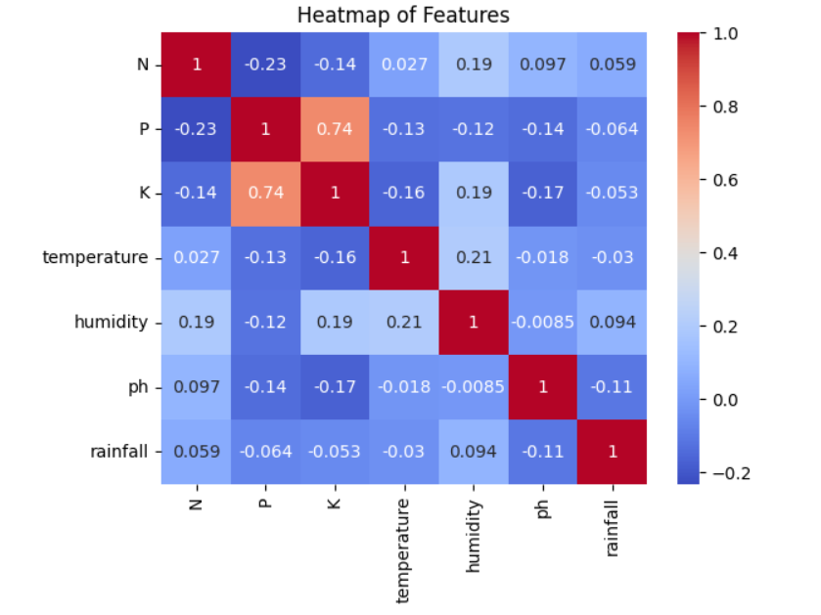
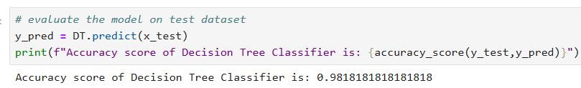
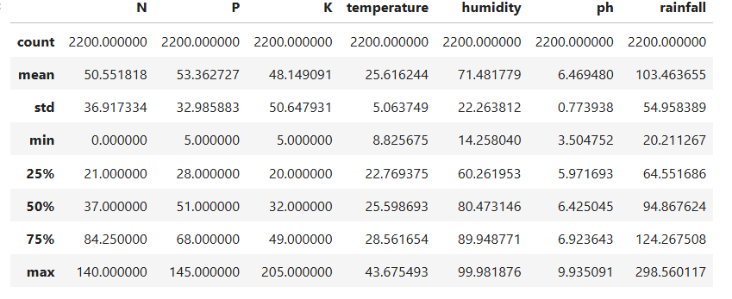
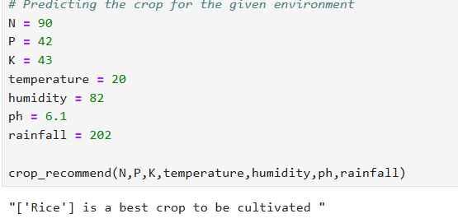
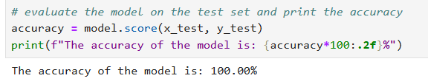
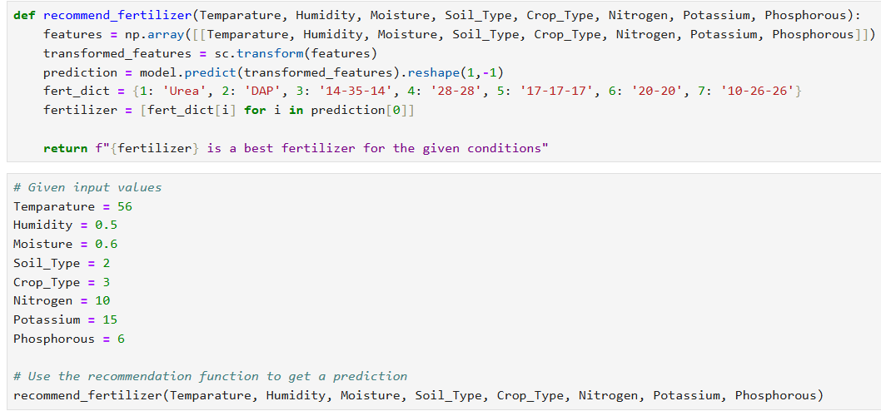
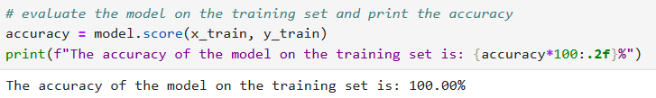
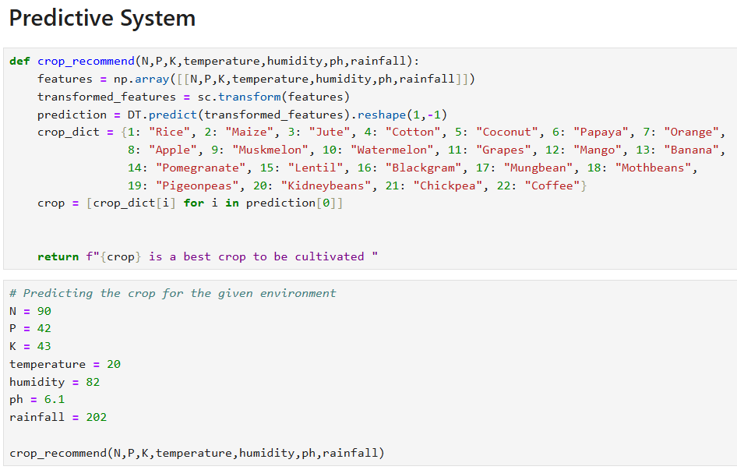
Screenshot of Output:

Slide 8
Conclusion:
The developed system effectively recommends the most suitable crop and ideal fertilizer based on soil and environmental parameters.
Leveraging Machine Learning and Streamlit, we achieved:
98% accuracy in crop prediction
100% accuracy in fertilizer recommendation
The solution empowers farmers with data-driven, eco-friendly decisions, contributing to sustainable agriculture.
It also promotes Green Skills through AI, helping bridge the gap between technology and traditional farming.
Future enhancements may include:
Integration with real-time sensors and satellite data
Regional language support and mobile app accessibility

